Slide 2
What's New in Windows Server Hyper-V
Ben Armstrong
Sarah Cooley

Slide 3
What is this about?
Giving you a detailed view of everything you can do with Hyper-V in Windows Server Technical Preview 2
It is not… A complete overview of everything that will be in the final release of Windows Server

Slide 4
Windows 10
Many of these features are / will be available in Windows 10!

Slide 5
Hyper-V on Nano Server
Nano Server is a great platform for Hyper-V
We will be using Nano Server for many of our demos today
Session: Nano Server: The future of Windows Server starts now

Slide 6
Windows Containers
Something
Session: Link to session

Slide 7
Making Cloud Great

Slide 8
Making Cloud Great
Security
Isolation
Availability
Operational Improvements
Scale

Slide 9
Security

Slide 10
Virtual Machine Protection
Trust is the biggest blocker to cloud adoption
We want to allow customers to know that their data is secure
Session: Harden the fabric: Protecting tenant secrets in Hyper-V

Slide 11
Virtual TPM & Linux Secure Boot
Ben Armstrong

Slide 12
Secure Boot Support for Linux
Providing kernel code integrity protections for Linux guest operating systems.
Works with:
Ubuntu 14.04 and later
SUSE Linux Enterprise Server 12

Slide 13

Secure Boot Support for Linux
PowerShell to enable this:
Set-VMFirmware "Ubuntu" -SecureBootTemplate MicrosoftUEFICertificateAuthority
Session: Virtualizing Linux and FreeBSD Workloads on Windows Server Hyper-V

Slide 14
Isolation

Slide 15
Distributed Storage QoS
Windows Server 2012 R2:
Introduced the ability to limit maximum IOPs for an individual virtual hard disk

Slide 16
Distributed Storage QoS
Windows Server Technical Preview :
Leveraging Scale Out File Server to allow you to:
Define IOPs reserves for important virtual hard disks
Define a IOPs reserve and limit that is shared by a group of virtual machines / virtual hard disks
Session: Hyper-V Storage Performance with Storage Quality of Service

Slide 17
Demo: Storage QoS
Notes:
Just VM Isolation Improvements for Friday? Maybe skip this demo altogether

Slide 18
Host Resource Protection
Dynamically identify virtual machines that are not “playing well” and reduce their resource allocation

Slide 19
Availability

Slide 20
Rolling Cluster Upgrade
You can now upgrade a 2012 R2 Hyper-V cluster to Windows Server Technical Preview with:
No new hardware
No downtime
The ability to roll-back safely if needed
Session: Upgrading your private cloud to Windows Server 2012 R2 and beyond!

Slide 21
Virtual Machine Storage Resiliency
Storage fabric outage no longer means that virtual machines crash
Virtual machines pause and resume automatically in response to storage fabric problems

Slide 22
Host Based Backup of Shared VHDX
In Windows Server 2012 R2 the backup story for Shared VHDX clusters was to use a guest agent
Now you can backup shared VHDX clusters as easily as any other virtual machine

Slide 23
Online Resize of Shared VHDX
You can now resize shared VHDX virtual hard disks while the guest cluster is running

Slide 24
Demo: Storage Availability

Slide 25
Runtime Memory Resize
Dynamic memory is great, but more can be done.
For Windows Server Technical Preview 2 guests, you can now increase and decrease the memory assigned to virtual machines while they are running.

Slide 26
Hot add / remove of network adapters
Network adapters can be added and removed from Generation 2 virtual machines while they are running.

Slide 27
Network Adapter Identification
You can name individual network adapters in the virtual machine settings – and see the same name inside the guest operating system.
PowerShell needed to configure naming

Slide 28
Replica Support for Hot Add of VHDX
When you add a new virtual hard disk to a virtual machine that is being replicated – it is automatically added to the not-replicated set. This set can be updated online.
Set-VMReplication "VMName" -ReplicatedDisks (Get-VMHardDiskDrive "VMName")

Slide 29
Demo: Hot Add

Slide 30
New VM Upgrade Process
Windows Server 2012 R2:
Hyper-V automatically upgrades virtual machines to the latest version
No ability to roll-back the upgrade process

Slide 31
New VM Upgrade Process
Windows Server Technical Preview:
Hyper-V will not automatically upgrade virtual machines
Upgrading a virtual machine is a manual operation that is separate from upgrading the host
Individual virtual machines can be moved back to earlier versions, until they have been manually upgraded

Slide 32
New VM Upgrade Process
Windows Server Technical Preview:
PowerShell only:
Update-VMConfigurationVersion

Slide 33
Demo: Upgrade

Slide 34
Operational Improvements

Slide 35
Production Checkpoints
Delivers the same Checkpoint experience that you had in Windows Server 2012 R2 – but now fully supported for Production Environments
Uses VSS instead of Saved State to create checkpoint
Restoring a checkpoint is just like restoring a system backup

Slide 36
PowerShell Direct to Guest OS
You can now script PowerShell in the Guest OS directly from the Host OS
No need to configure PowerShell Remoting
Or even have network connectivity
Still need to have guest credentials

Slide 37
ReFS

Slide 38
Hyper-V Manager Improvements
Multiple improvements to make it easier to remotely manage and troubleshoot Hyper-V Servers:
Support for alternate credentials
Connecting via IP address
Able to manage Windows Server 2012, 2012 R2 and Technical Preview from a single console
Connecting via WinRM

Slide 39
PowerShell Improvements
Multiple improvements to make it easier to remotely manage and troubleshoot Hyper-V Servers:
Support for alternate credentials
Windows 10 and 2012 R2 modules included (v1.1 and v2.0)
Connecting via WinRM

Slide 40
Demo: Operational Improvements

Slide 41
Changing how we handle VM servicing
Windows Server 2012 R2:
VM drivers (integration services) updated with each new host release
Require that VM driver version matches the host
Drivers shipped with host operating system
Notes:
Talking points:
This approach made a lot of sense in 2008. Most operating systems were not-enlightened, and needed updated drivers. In most scenarios the Hyper-V administrator and the guest administrator were the same person.
This is no longer the case.

Slide 42
Changing how we handle VM servicing
Windows Server Technical Preview:
VM drivers (integration services) updated when needed
Require latest available VM drivers for that guest operating system
Drivers delivered directly to the guest operating system via Windows Update
Notes:
Talking points:
Now, most operating systems come with drivers that support

Slide 43
Working better at scale

Slide 44
Evolving Hyper-V Backup
New architecture to improve reliability, scale and performance.
Decoupling backing up virtual machines from backing up the underlying storage.
No longer dependent on hardware snapshots for core backup functionality, but still able to take advantage of hardware capabilities when they are present.

Slide 45
Built in change tracking for Backup
Most Hyper-V backup solutions today implement kernel level file system filters in order to gain efficiency.
Makes it hard for backup partners to update to newer versions of Windows
Increases the complexity of Hyper-V deployments
Efficient change tracking for backup is now part of the platform

Slide 46
VM Configuration Changes
New virtual machine configuration file
Binary format for efficient performance at scale
Resilient logging for changes
New file extensions
.VMCX and .VMRS

Slide 47
Hyper-V Cluster Management
Providing a single view of an entire Hyper-V cluster through WMI
“Just one big Hyper-V server”
Limited functionality at this point in time:
Enumerate virtual machines
Receive notification of live migration events
Root\HyperVCluster\v2

Slide 48
Demo: VM Configuration & Multi-host Management

Slide 49
Enhancing the platform

Slide 50
Hypervisor power management improvements
Updated hypervisor power management model to support new modes of power management.

Slide 51
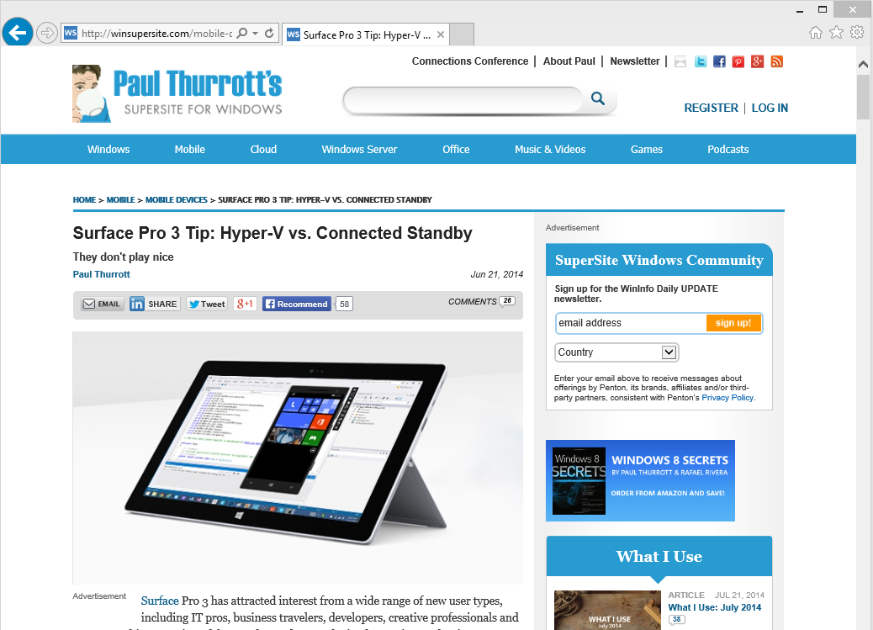
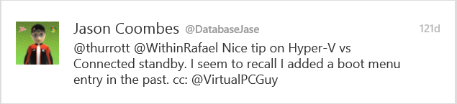
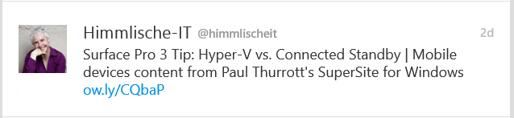
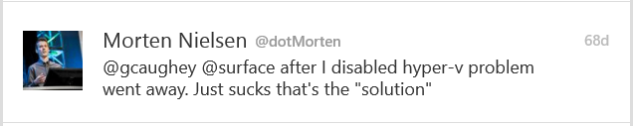
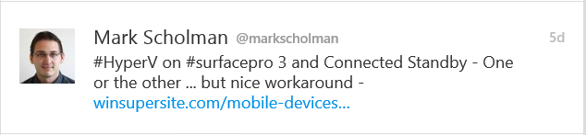
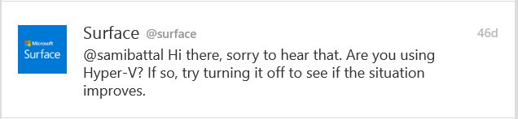
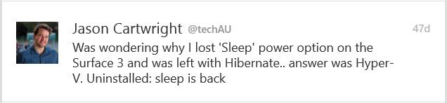
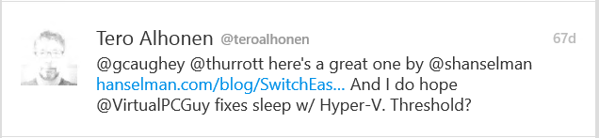
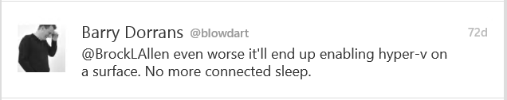
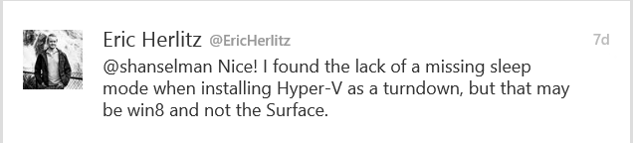

Slide 52
Hypervisor power management improvements
Updated hypervisor power management model to support new modes of power management.
Connected Standby works!

Slide 53
RemoteFX Improvements
Support for OpenGL 4.4 and OpenCL 1.1 API
Larger dedicated VRAM and configurable VRAM.

Slide 54
Summary
Lots of new functionality in Windows Server Technical Preview 2!
More to come in the future!
Please try out the new functionality – and provide us with feedback!
Talk to us at @VirtualPCGuy and @VirtualScooley

Slide 56
ATTENTION: PLEASE READ
Photography and copyright infringement.
Using imagery from movies, television, music and pop-culture is illegal, unless purchased, licensed or by express written consent from the owner. Please do not include unlicensed imagery in your presentation.
Sessions with questionable imagery will not be published until resolved. The speaker will be contacted via email for immediate resolution. If additional costs are incurred in editing, an I/O Code will be required.
If you have any questions regarding your imagery please contact
Media Acquisitions Inquiries: mediaacq@microsoft.com.
The PPT deck and Recording will not be published until the editing is complete.

Slide 57
If an image is on the Internet/Bing it is in the public domain.
If there is no copyright notice on the image, I don’t need permission.
If I don’t profit from the use, I don’t need permission.
If I remove the image after notice, I don’t owe any money to the copyright.
If I alter the image X%, I don’t need permission.
If I only use a part of the image, I don’t need permission.
If I only include a hyperlink in my presentation and click it to show the image, I don’t need permission.
Common Copyright Myths

Slide 58
Resources for Microsoft employees
Can’t find the image that you have in mind for your presentation? The Media Acquisitions team can help you find and license imagery through our stock photography providers. You will also find imagery and information via these links:
Mediaacq
Microsoft Brand Tools
Presentation guidelines
Microsoft photography
Microsoft illustrations
www.superstock.com/
www.gettyimages.com/creativeimages/royaltyfree
www.corbisimages.com/stock-photo/royalty-free
(Media Acquisitions alias)
There are agreements in place with these providers.
For information on the use of third-party copyrighted content: http://lcaweb/CTP/Copyrights/Third-Party-Content-Use/Pages/default.aspx

Slide 59
Preferred text layout (no bullets)
Main topic 1: size 40pt
Size 20pt for the subtopics
Size 20pt for the subtopics
Main topic 2: size 40pt
Size 20pt for the subtopics
Size 20pt for the subtopics
Main topic 3: size 40pt
Size 20pt for the subtopics
Size 20pt for the subtopics

Slide 60
Preferred text layout (no bullets)
Main topic 1: size 40pt
Size 20pt for the subtopics
Size 20pt for the subtopics
Main topic 2: size 40pt
Size 20pt for the subtopics
Size 20pt for the subtopics
Main topic 3: size 40pt
Size 20pt for the subtopics
Size 20pt for the subtopics

Slide 61
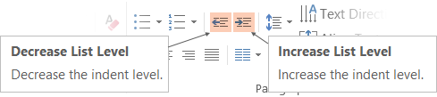
Adjusting list levels
Main topic 1: size 40pt
Size 20pt for the subtopics
Size 20pt for the subtopics
Main topic 2: size 40pt
Size 20pt for the subtopics
Size 20pt for the subtopics
Main topic 3: size 40pt
Size 20pt for the subtopics
Size 20pt for the subtopics
Use the “Decrease List Level” and “Increase List Level” tools on the Home Menu to change text levels.
Try this:
Place your cursor in any row of text to the left that says “Size 20pt for subtopics”
Next click the Home tab, and then on the “Decrease List level” tool. Notice how the line moves up one level.
Now try placing your cursor in one of the “Main topic…” lines of text. Click the “Increase List Level” tool and see how the text is pushed in one level
Use these 2 tools to adjust your text levels as you work

Slide 62
Bullet points layout with subtitle Subtitle
Example of a bulleted slide with a subhead
Set the slide title to “Sentence case”
Set subheads to “Sentence case”
Hyperlink style
www.microsoft.com

Slide 63
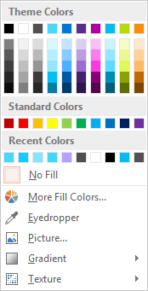
Slide palette info
The PowerPoint palette for this template has been built for you and is shown below. Avoid using too many colors in your presentation.
Accent colors 1-6 – (6 Theme Colors to the far right)
Text
Light 2
Accent 1
Accent 2
Accent 3
Accent 4
Accent 5
Accent 6
Use Accent 1 as the main accent color. Use Accent 2 and Accent 3 when additional colors are needed.
Use Accents 4-6 sparingly – only when more colors are necessary.

Slide 64
Video

Slide 65
Demo
Speaker name

Slide 66
Photo layout 1

Slide 67

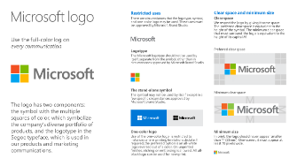
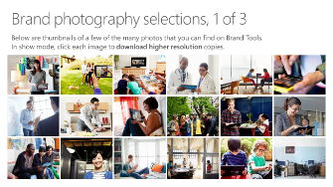
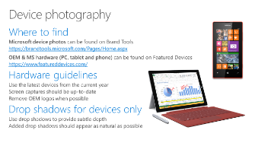
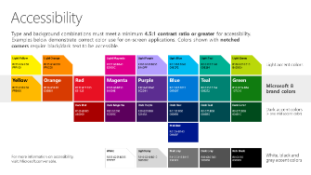
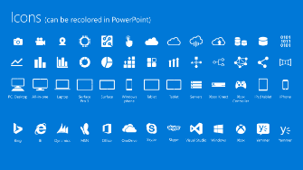
Microsoft brand guidelines
Looking for more slide resources?
Brand guidelines for PowerPoint templates is a separate slide deck that provides an overview of the Microsoft brand, guidelines, resources, tips and much more.
A few of the slides are shown at right.
Download from: https://brandtools.microsoft.com/Resources/Presentations/Pages/StoryBoard.aspx?section=Elements1

Slide 68
Section title

Slide 69
Section title

Slide 70
Section title

Slide 71
Section title

Slide 72
Section title

Slide 73
Software code slide
This slide layout uses Consolas, a monotype font which is ideal for showing software code.

Slide 74
Notes (hidden)
Some speakers at Microsoft like to use this slide for hidden “notes slides”.
Delete it if you don’t want to use it.
NEXT: <next slide title>

